Slide 1
UEN002 – Energy and Environment
In the previous session, we went through…..
Energy recovery from Municipal solid waste through Incineration, Pyrolysis and Gasification

Slide 2
Composting MSW
Direct introduction of shredded organic MSW to soil | Introduction of compost to soil
Undesirable reactions: Anaerobic transformation will produce gases such as ammonia, hydrogen sulfide, methane,etc., some of which are toxic to plant growth Competitions of microbes for plant nutrients: Most of the nutrients that are present in waste will be consumed by growing microbes making it unavailable to plants | Mineralizing the simple, early assimilable substances i.e., proteins, cellulose, lignin and lipids to carbondioxide and simple nitrogen compounds Humifying more complex compounds to produce more homogenous and stable organic products which do not undergo further rigourous change The final humus-like product is hygenically safer, aesthetically appealing and will contain less odourous substances than original MSW

Slide 3
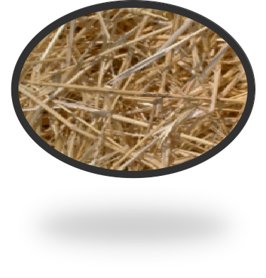
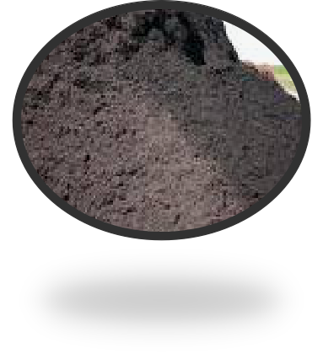
Compost : Mechanism of Composting
Composting is a biochemical process in which aerobic and anaerobic microorganism decomposes organic matter into valuable manure called as compost.
Release heat
(Thermophilic state, which helps to destroy pathogens)
Organic matter
Organic matter
compost
Temp 55-60º c
(Mesophilic state ,Temp. 25-30o c, promote mesophilic microbes for rapid decomposition )

Slide 4
Composting
Composting is defined by human intervention into the natural process of decomposition.
With a combination of proper environmental conditions and adequate time, microorganisms turn raw putrescible organic matter into a stabilized product.
Through composting, readily available nutrient and energy sources are transformed into carbon dioxide, water, and a complex form of organic matter — compost.
Process management can be optimized for a number of criteria, including the rate of decomposition (to reduce residence time in reactors and thus minimize facility size requirements), pathogen control, and odour management.
The key parameters are the, microbial load, available carbon to nitrogen (C:N) ratio, moisture, oxygen, and temperature.

Slide 5
Role of microbes in composting
The most active players in composting are bacteria, actinomycetes, fungi and protozoa
They are naturally present in most organic waste materials
Composting is mainly dependent on succession of microbial activities – environment created by one group promotes activity of the successor group
Different type of microbes are active at different phases in the composting pile
Bacteria and fungi have important role in decomposition process
Optimal regime of these organisms can be classified as mesophilic (25 – 45ºC) and thermophilic (45 – 70ºC)

Slide 6
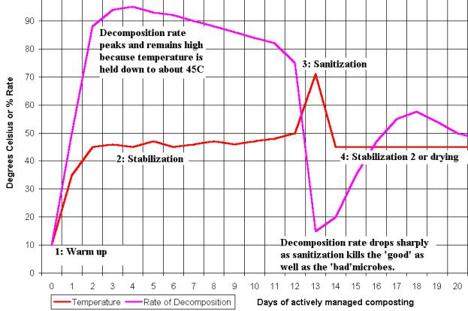
Composting temperatures
Thermophilic
Mesophilic

Slide 7
Role of microbes in composting – Mesophilic phase
Mesophilic organisms experience most rapid growth at temp. 25-45 deg C
Dominant within early phase of composting when temperature is near ambient
Oxygen available in void space is used for oxidation of carbon to energy
End products include carbondioxide and water
As a part of the process, over time, heat is generated as chemical bonds in the substrate are broken during metabolism
When the pile is insulated by dry mass on the surface, most of the heat generated is trapped within the pile
In the insulated center, when temperature builds up beyond 45ºC, the mesophiles die or are inactivated

Slide 8
Role of microbes in composting – Thermophilic phase
Temperature of 45 deg C and above activates thermophiles
These multiply, metabolize substrates and gradually replace mesophiles in most section of compost pile
They generate greater quantities of heat than mesophiles
As the temperature reaches to about 60 deg C, most of the pathogens and weed seeds are killed
The thermophiles continue decomposing the feedstock as long as the nutrients and energy sources are available
As the substrate depletes, the thermophiles die and the pile temperature falls
With the fall in temperature, mesophiles get reactivated decomposing rest of the substrate

Slide 9
Biological Process Control
Forced aeration systems are commonly used during this stage of composting, using temperature sensors to control blowers.
Eventually, as readily available compounds are decomposed, the rate of composting slows, with less oxygen required and less heat generated.
This slower stage is called curing, and while it requires less management than active composting, it is important to compost quality.
Methods
  Windrow
  Static pile
  In-vessel composting
  Vermicomposting

Slide 10
Technologies and aeration methods
A variety of technologies have been adapted for use with MSW, which can be roughly divided into four groups: windrows, static piles, and vertical reactors.
Windrows are defined as regularly turned elongated piles, shaped like a haystack in cross section and up to a hundred meters (yards) or more in length.
Process control is normally through pile management as described above, although forced aeration can also be used.
The cross-sectional dimensions vary with feedstock and turning equipment, but most MSW windrows are 1.5 to 3 meters (yards) high and 3 to 6 meters (yards) wide. Individual windrows may be constructed over a period of several days or weeks, but are usually each managed as a single batch.

Slide 11
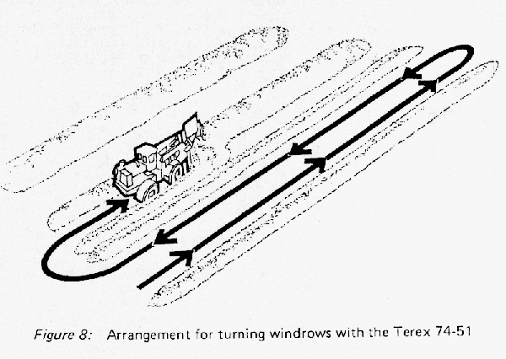
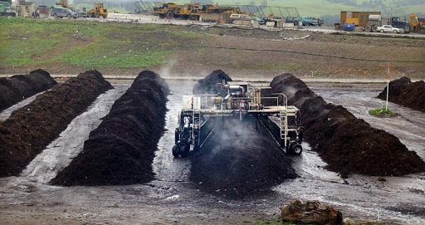
windrow

Slide 12
Technologies and aeration methods
Static piles can be shaped much like windrows or in an elongated pile or bed. The essential difference is in the name; static piles are not mechanically agitated.
Once constructed by conveyor, loader or truck, the piles remain in place until the decomposition slows.
The lack of agitation requires the maintenance of adequate porosity over an extended period of time.
When composting fine materials like sludge, a coarse stable substrate such as wood chips is often incorporated in the mix. Inert materials or slowly degrading cellulosic substrates like cardboard or leaves may help supply that stable porous structure in MSW, but this needs to be considered in the preprocessing system design.

Slide 13
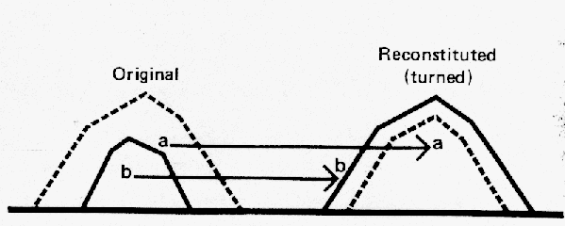
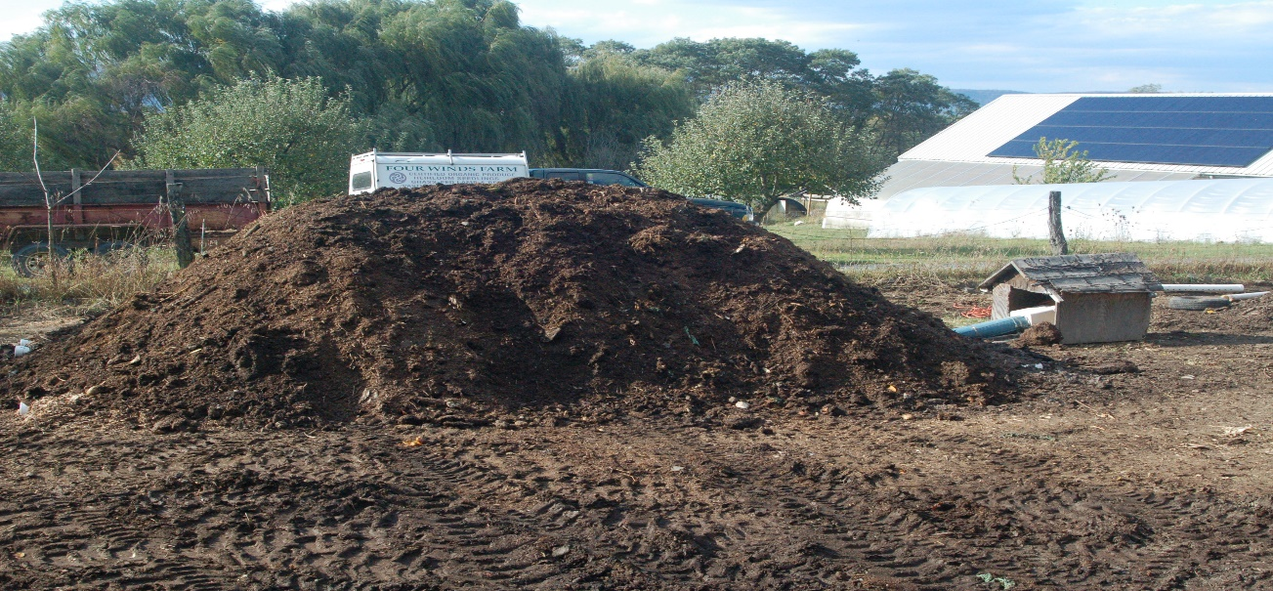
Static pile

Slide 14
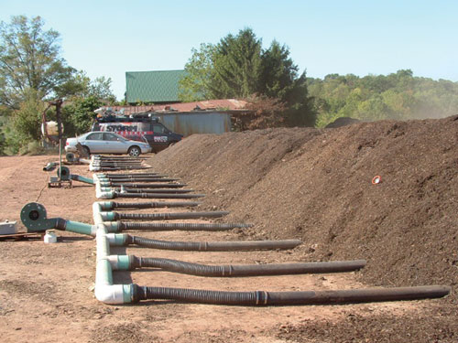
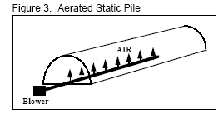
Technologies and aeration methods
Process control is normally through pressure and/or vacuum-induced aeration, with either temperature or oxygen as the control variable.
Blower piping can be temporary plastic or metal in a bed of coarse material at the base of the pile, or recessed into the composting pad under perforated plates.
Piles are often covered with a layer of wood chips or mature compost to insulate the active compost from ambient temperatures and/or provide some odour treatment.
Both windrows and static piles are often outside and exposed to weather, but can be covered with a roof to minimize the impacts of weather and provide an opportunity for odour capture and treatment.

Slide 15
Technologies and aeration methods
Vertical composting reactors are generally over 4 meters high, and can be housed in silos or other large structures.
Organic material is typically fed into the reactor at the top through a distribution mechanism, and flows by gravity to an unloading mechanism at the bottom.
Process control is usually by pressure-induced aeration, where the airflow is opposite to the downward materials flow.
The height of these reactors makes process control difficult due to the high rates of airflow required per unit of distribution surface area. Neither temperature nor oxygen can be maintained at optimal levels throughout the reactors, leading to zones of non-optimal activity.

Slide 16
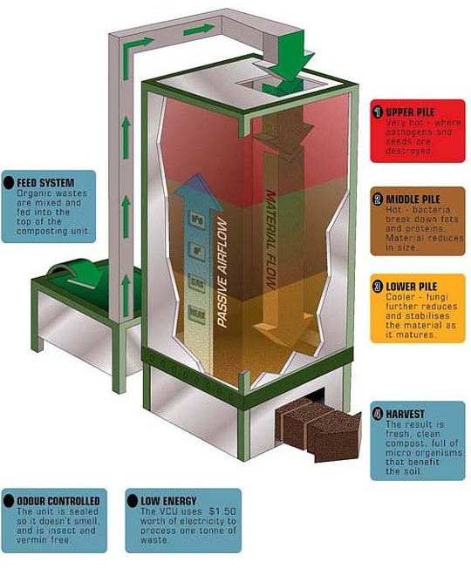
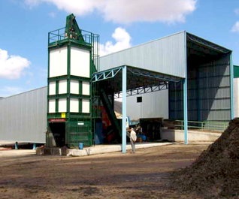

Slide 17
Potential for composting MSW
Among the many criteria available for evaluating system performance, three stand out as particularly important for MSW composting: product quality,percent rejects, and recycling rate.
Compost product quality can include aesthetic, functional, and contaminant characteristics, all of which are clearly critical to product marketability.
Percent rejects and recycling rate both have an impact on the amount of rejected waste needing disposal and on compost quality by effecting contaminant concentrations.
The practical application of this process to MSW, is limited by three problems:
Lack of markets for the finished product
Small reduction in the total refuse content/volume requiring disposal
Environmental factors of composting plants (odour, vector, bird menace, etc,)

Slide 18
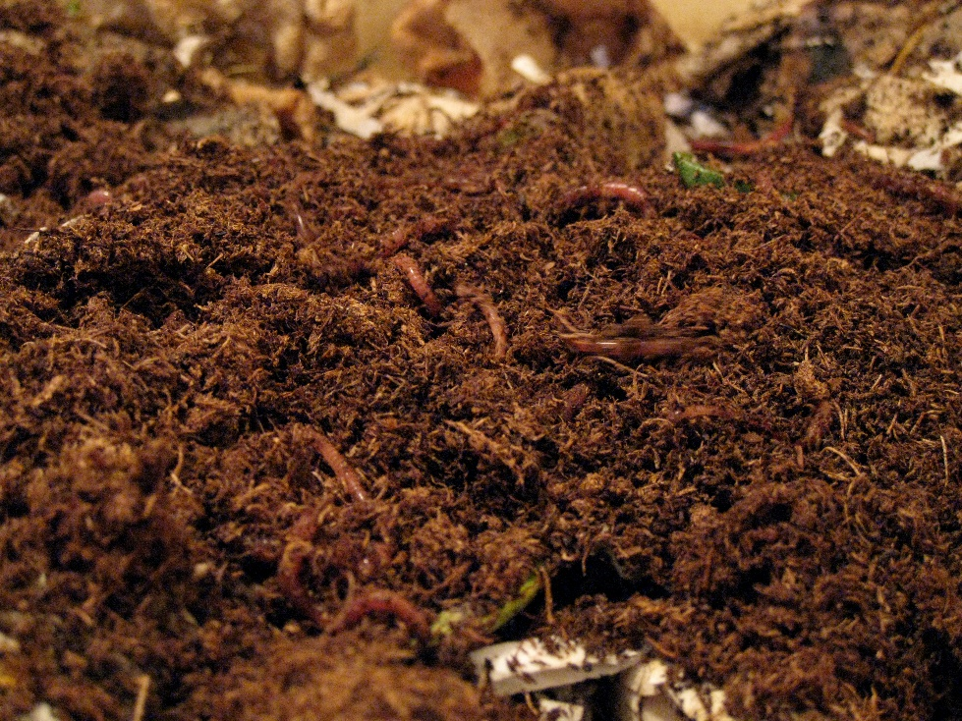
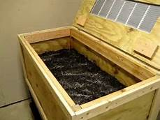
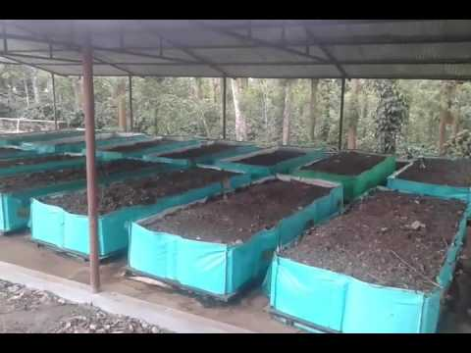
vermicomposting
Increase in crop for improving fertility and health of the soil
Increase in retention of soil moisture
Increase in nutrient value of organic waste

Slide 19
In the next……
You will be introduced to
  Engineered landfills and management of solid waste disposal

